Slide 1
VALIDATION
LaunchCode LC101 – Class 2.5

Slide 2
Client-Side Validation
What is it?
Validate the data in the browser before the
user clicks submit

Slide 3
Client-Side Validation
Why do we do it?
Pro:
Con:
Real time validation, our user
doesn’t have to click submit.
Easily breakable

Slide 4
Client-Side Validation
What are some examples?
HTML attributes
JavaScript
Can build validation code, that verifies pre-submit
<input type="email">
https://developer.mozilla.org/en-US/docs/Web/HTML/Element/input#Attributes
Any Questions?
Notes:
The lesson Does not go back and talk about client side validation at all….

Slide 5
Server-Side Validation
What is it?
Validate after they click submit, in our code on the server.

Slide 6
Server-Side Validation
Why do we do it?
Pro:
Con:
It can’t be bypassed.
Slower feedback to the user

Slide 7
Server-Side Validation
What are some examples?
Request Handlers
Model Classes
Class that relates to the model

Slide 8
Request Handlers
Make a form with placeholders

Slide 9
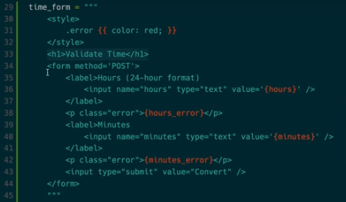
Request Handlers

Slide 10
Request Handlers
Make a form with placeholders
2) Make a handler to display the form the first time

Slide 11

Request Handlers

Slide 12
Request Handlers
Make a form with placeholders
2) Make a handler to display the form the first time
3) Pass in empty strings for the place holders

Slide 13

Request Handlers
Why pass in the empty strings?

Slide 14
Request Handlers
Make a form with placeholders
2) Make a handler to display the form the first time
3) Pass in empty strings for the place holders
4) Make second handler for post request

Slide 15
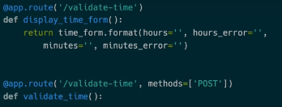
Request Handlers

Slide 16
Request Handlers
Make a form with placeholders
2) Make a handler to display the form the first time
3) Pass in empty strings for the place holders
4) Make second handler for post request
5) Create validation

Slide 17
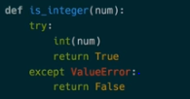
Request Handlers
What is this?

Slide 18
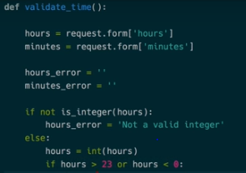
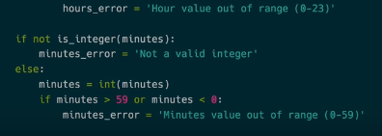
Request Handlers
Your logic will be
different!

Slide 19
Request Handlers
Make a form with placeholders
2) Make a handler to display the form the first time
3) Pass in empty strings for the place holders
4) Make second handler for post request
5) Create validation
6) If validation fails: Return form with error messages

Slide 20
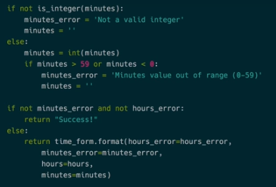
Request Handlers
Extra Step: Be nice to your user and leave the valid data there for them.

Slide 21

Request Handlers
Return their data and the error messages:

Slide 22
Request Handlers
Make a form with placeholders
2) Make a handler to display the form the first time
3) Pass in empty strings for the place holders
4) Make second handler for post request
5) Create validation
6) If validation fails: Return form with error messages
7) If validation passes: go to next display
8) Request Handler Questions?

Slide 23

Redirects – How to
1) New Handler
2) Modify code to redirect

Slide 24
Redirects – Behind the scenes
One of the best ways to pass data is….?

Slide 25

Redirects - Query Parameters
Put it into the Query parameter
2) Get it back out
When is it a bad idea to use Query Parameters?

Slide 26
HTML Escaping
What is it?
Why do we do it?
How do we currently do it?

Slide 27
HTML Escaping
However, it doesn't escape characters beyond &, <, and >.
If it is used as:
cgi.escape(string_to_escape, quote=True)
it also escapes "
https://wiki.python.org/moin/EscapingHtml

Slide 28

Cyber Security
“Cross-site scripting carried out on websites accounted for roughly 84% of all security vulnerabilities (…)as of 2007. Bug bounty company HackerOne in 2017 reported that XSS is still a major threat vector.
XSS effects vary in range from petty nuisance to significant security risk, depending on the sensitivity of the data and the nature of any security mitigation implemented by the site's owner.” (YOU)

Slide 29
Cyber Crime
Estimates:
How much is the annual damage to the global economy?
$445 billion
How much was lost in 2012 to online credit and debt fraud in the US?
$1.5 billion
A 2016 study thought that cybercrime in 2019 could cost?
$2.1 trillion

Slide 30
Cyber Security
Can you think of a time in the news when a major company got hacked?

Slide 31
In Summary
Validate Everywhere
Know how to Validate
If you find this material fascinating, you can go into Cyber Security
In general, we can now move from one page to another.

